Slide 1

Adult Income Prediction
Above and below 50k
Aaron Carney
Springboard 12/21

Slide 2
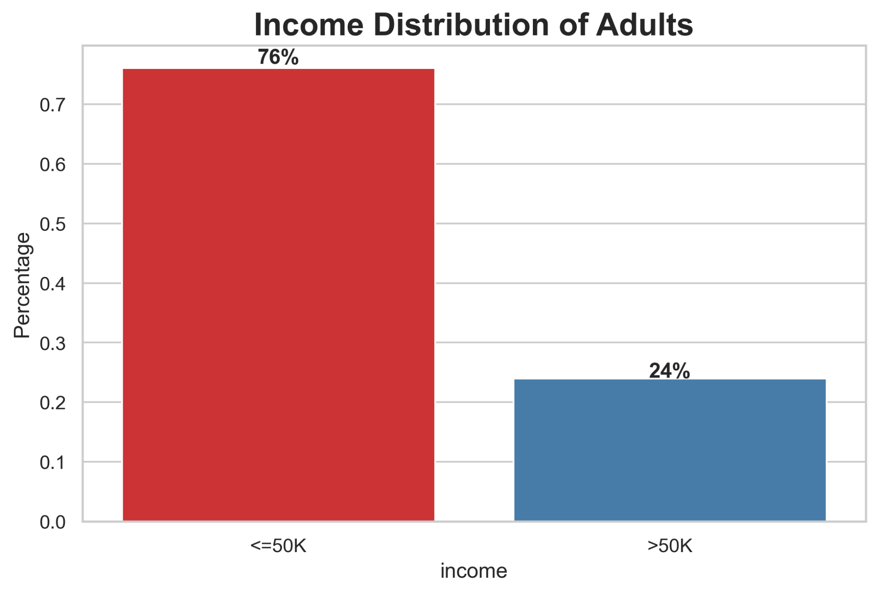
Notes:
Introduction of adult income distribution: Share the basic information and state that we will be searching for criteria which greatly steps away from this 76/24 split. The bigger the difference the greater the influence.

Slide 3
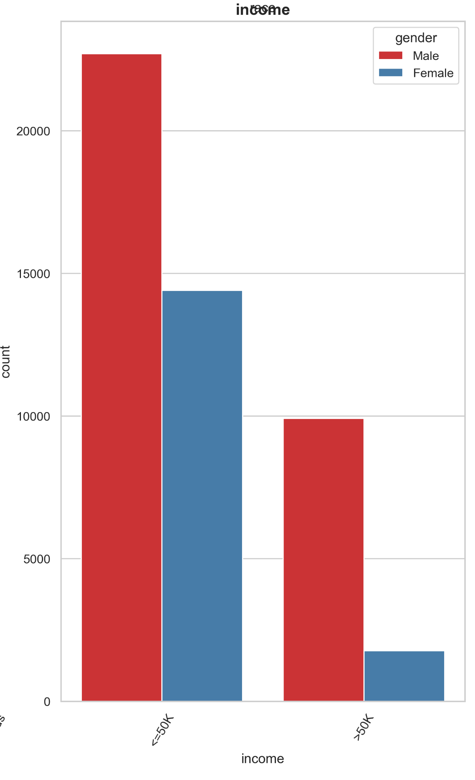
Normalized
Earning > 50K : 58% are Females || 42% are Males
Earning <= 50K : 28% are Females || 72% are Males
Notes:
Ed audience on normalization, There are more males in the data pool than female. So if we resample with equal counts of male and female we get normalized data

Slide 4
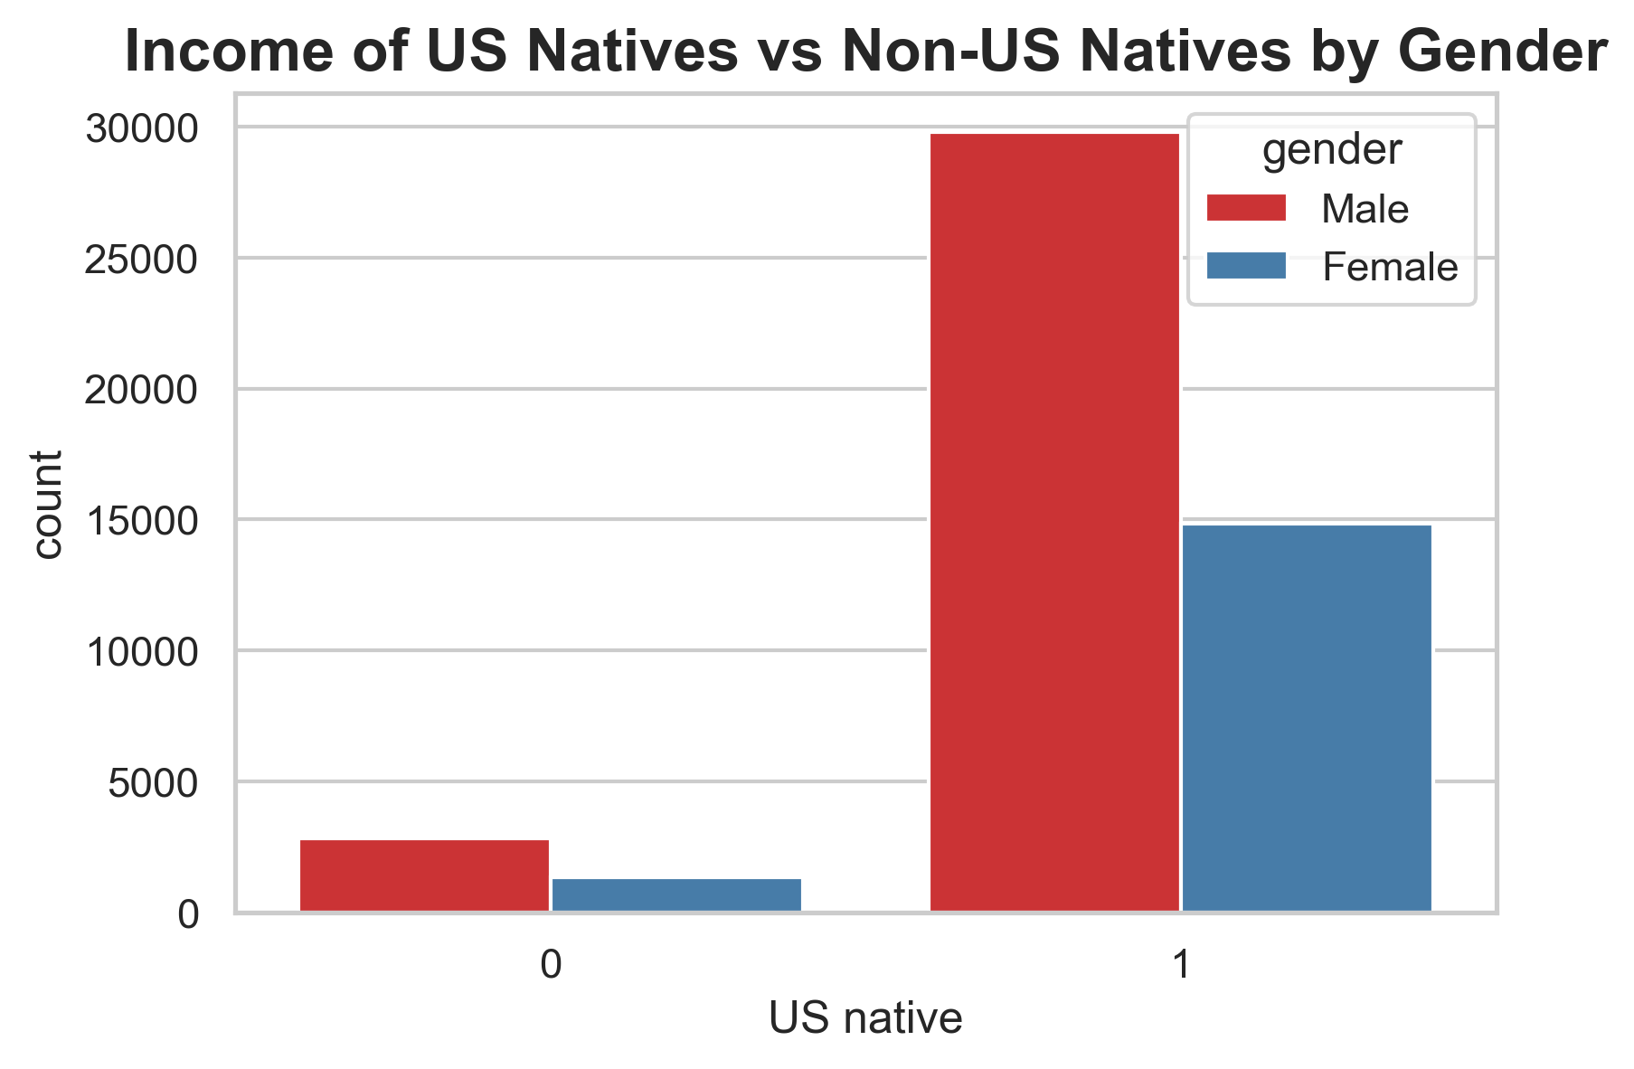
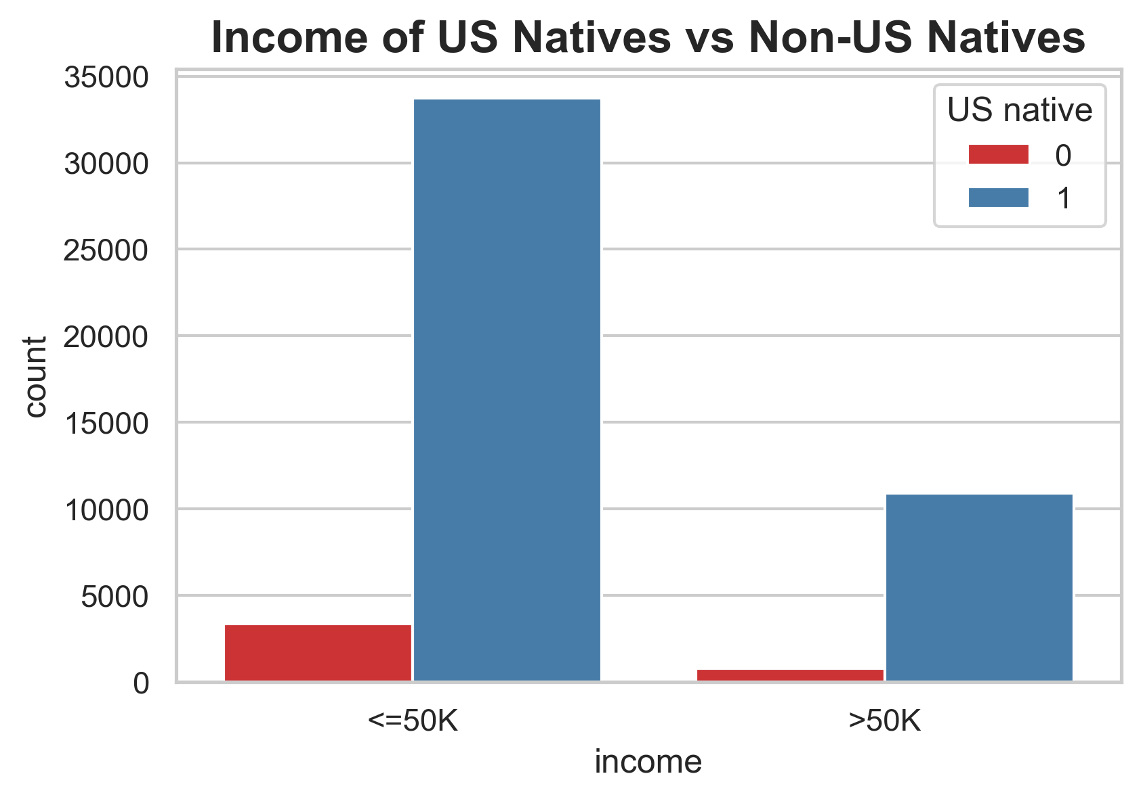
Notes:
Show the info on how many people polled are US natives as well as a raw count of how many are below and above 50k

Slide 5
Raw:
Among Natives : 24% earn >50K || 76% earn <=50K
Among Foreigners : 19% earn >50K || 81% earn <=50K
Normalized:
Earning > 50K : 57% are natives || 43% are foreigners
Earning =< 50K : 48% are natives || 52% are foreigners
Notes:
Review of the previous slide progressing to the normalized data.

Slide 6
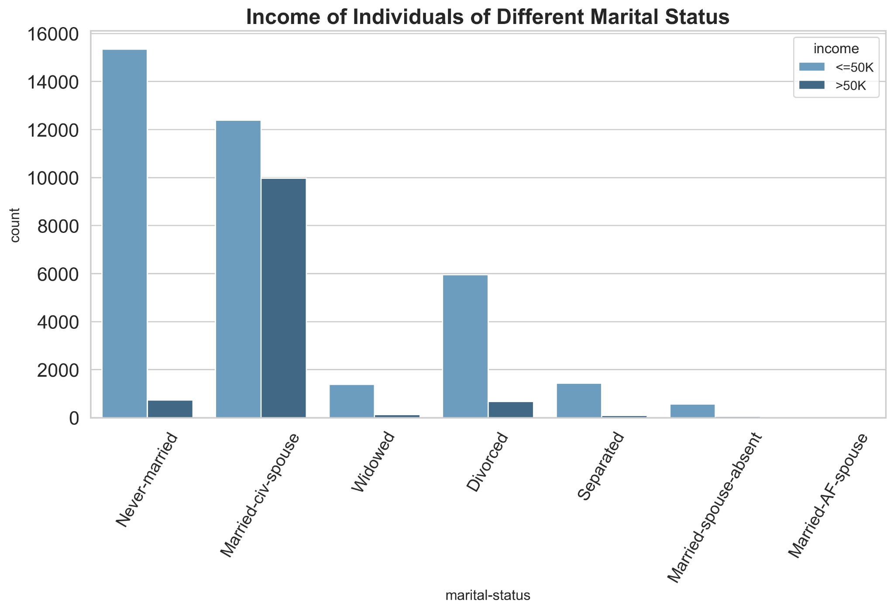
Notes:
Highlight how married people have a much higher ratio of people making above 50k. Hypothesis this may be due to those who know how to balance a relationship are better able to balance work relationships.

Slide 7
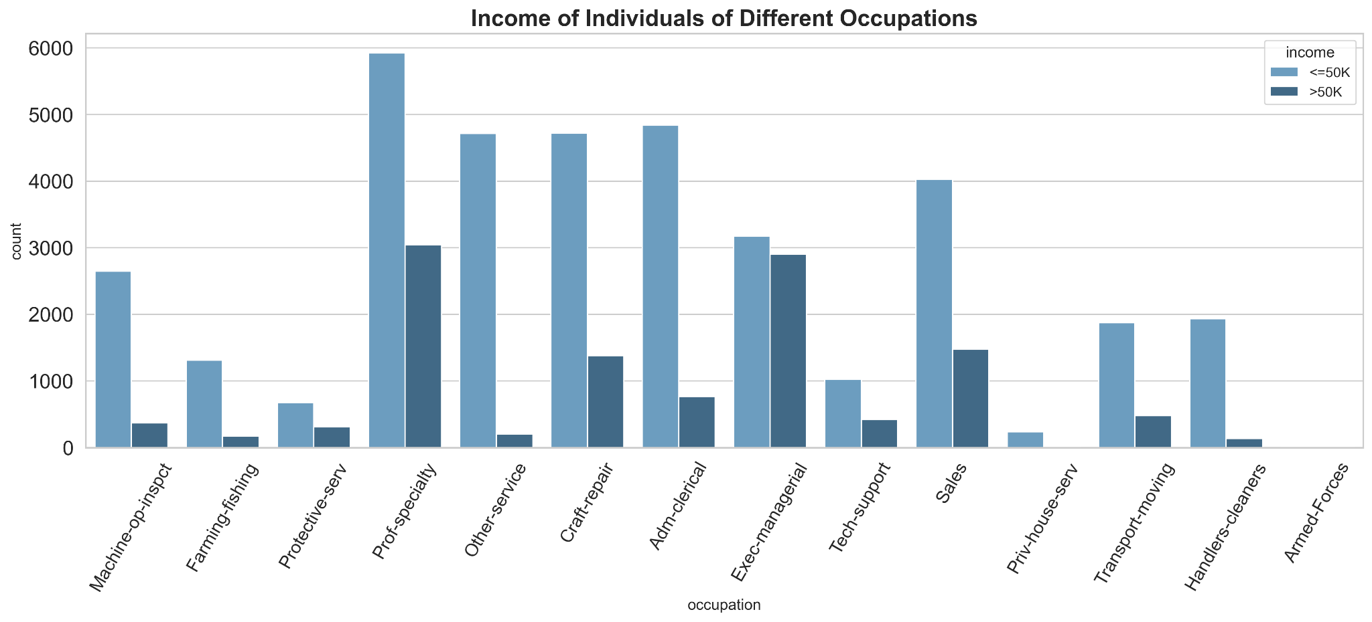
Notes:
Point out the high and low outliers, each one by one. Take this time to ask any questions with more detailed information on hand.

Slide 8
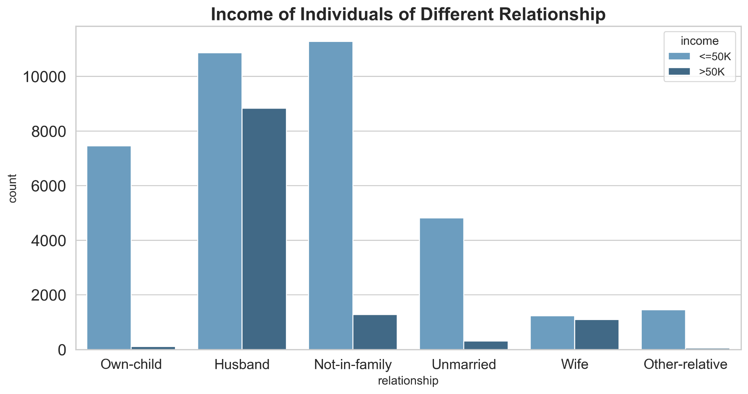
Notes:
Point out again, as before with those who are in a married relationship, those who are husbands or wives they have a much greater chance of earning over 50k

Slide 9
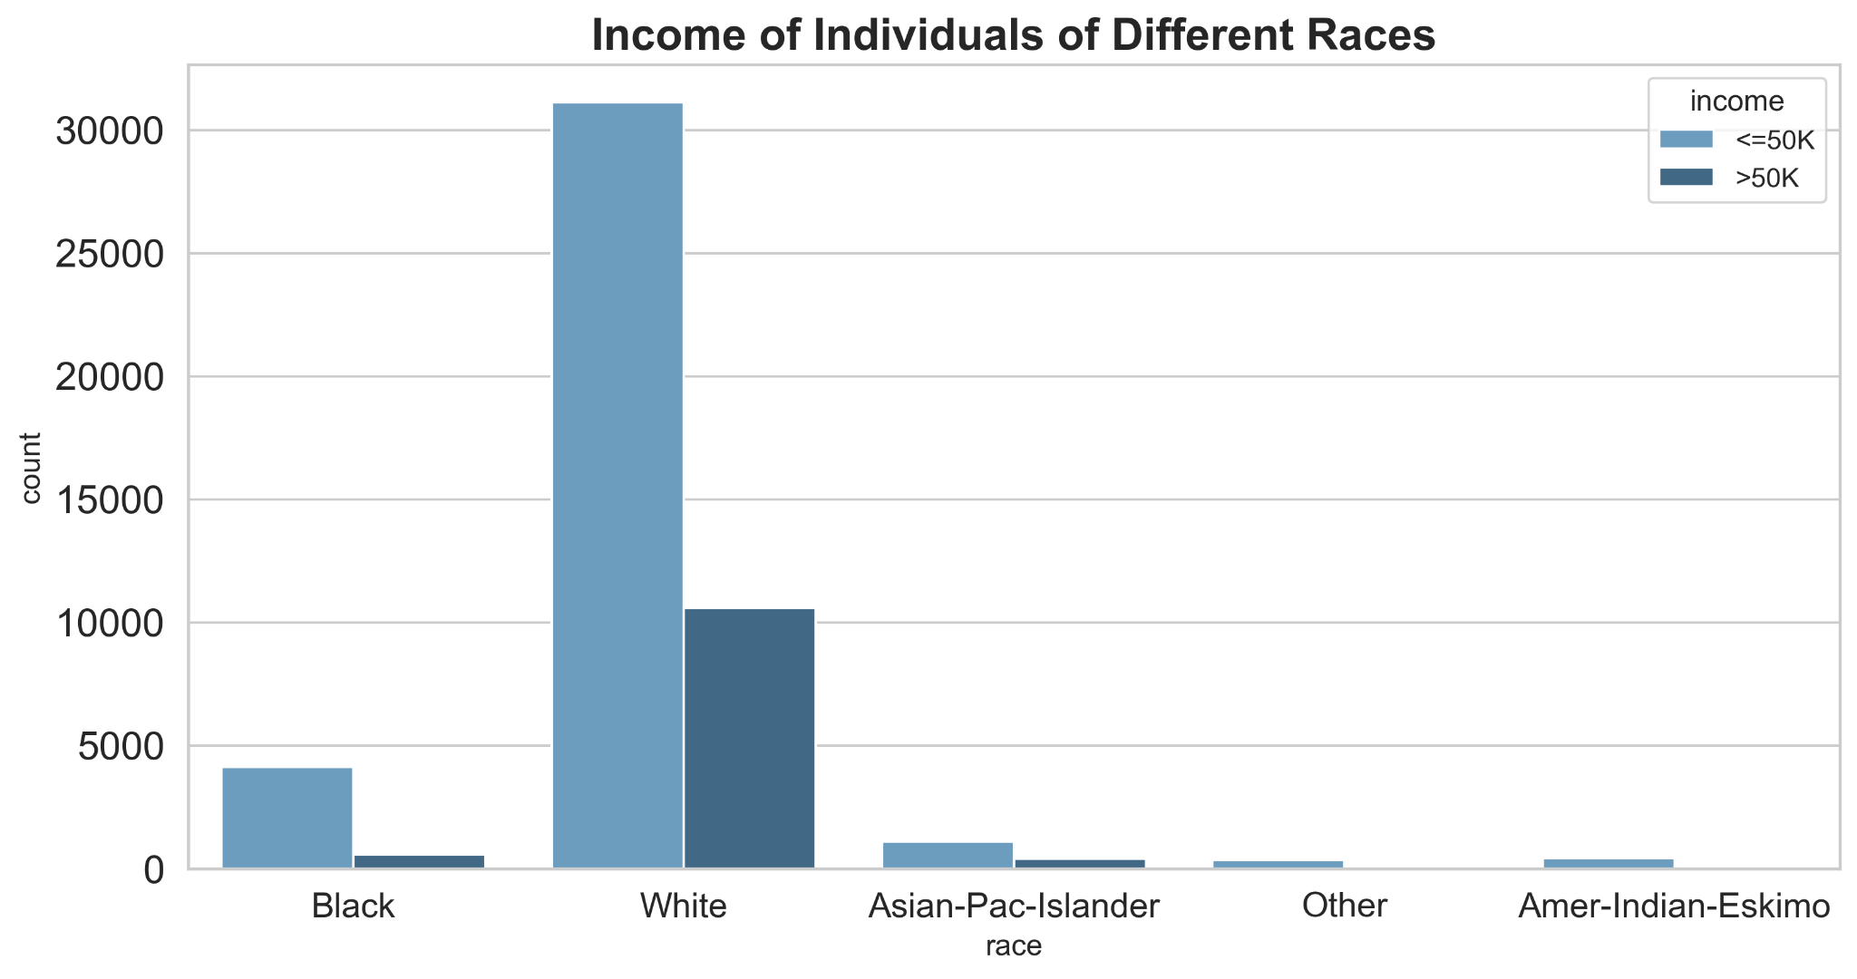
Notes:
Getting racial, show the ratio's, also point out this data doesn't show any big outliers

Slide 10
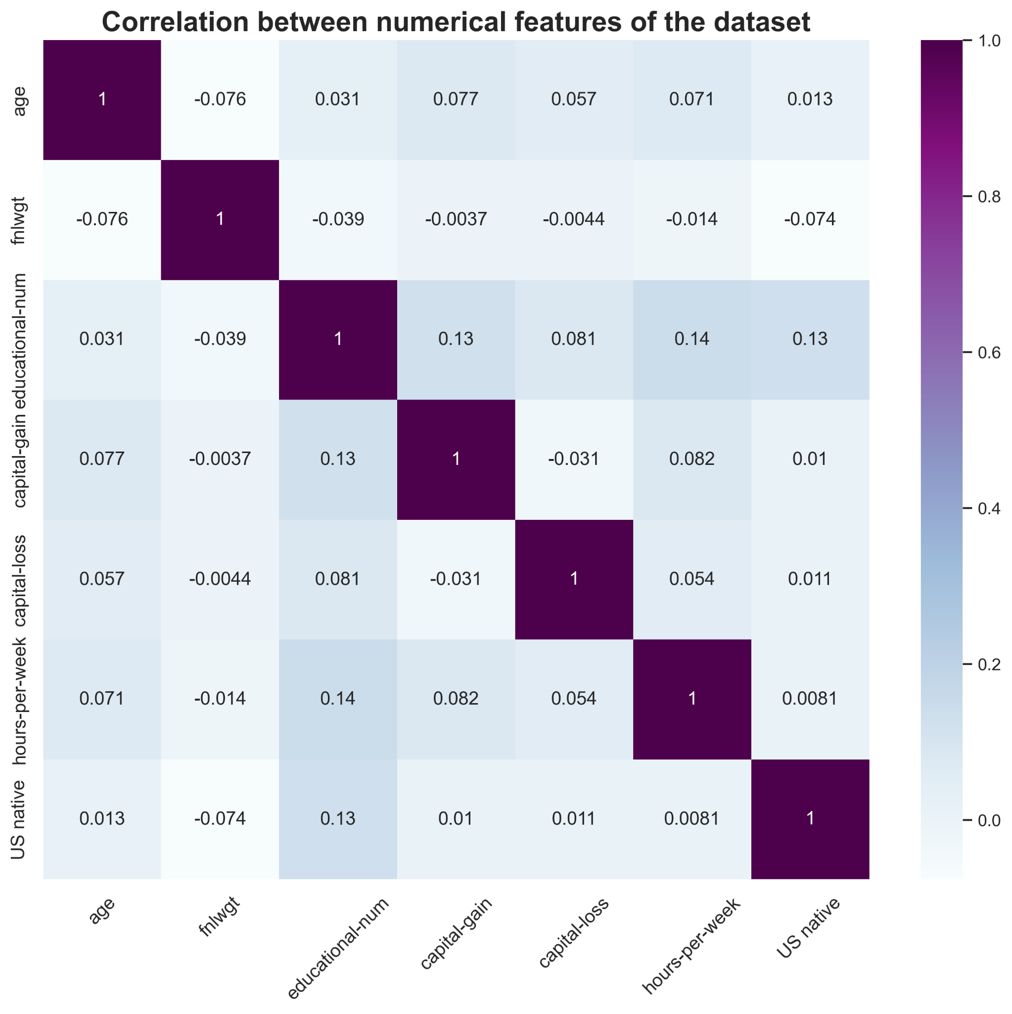
Notes:
Show the greatest level of correlations, being education / capital gain, Ed/hours per week, and US native / Ed.

Slide 11
Highlights
Committed Relationships
Education
Notes:
Refresh on the highlights

Slide 12
Questions:

